Slide 1
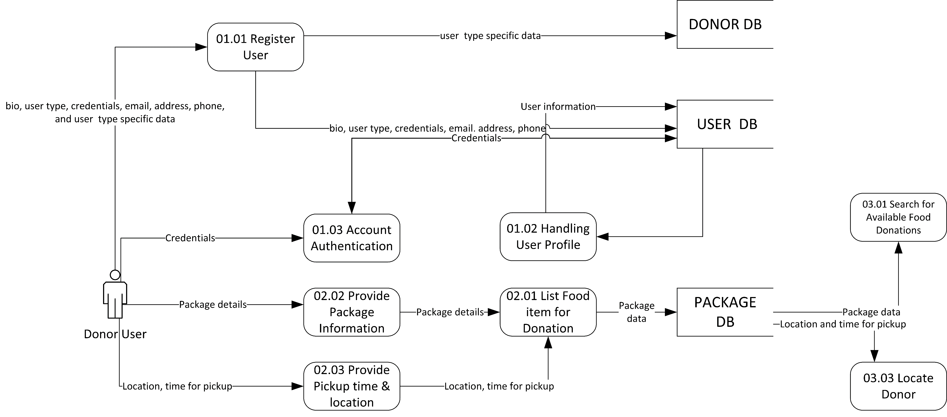
FoodPatry Data Flow Diagram(Physical)

